Slide 1
FSC Forest Certification
Market Trends; Looming Problem or Potential Opportunity?

Slide 2
Why Should We Care About Forest Certification?
Sustainability is a ‘Mega Trend’ for this century.
Product Sourcing (Where, How, Who) is a very real concern for the more affluent segment of the consumer market. Estimates are that FSC certified wood alone comprises 5% of the total US marketplace for forest products which is a proportionally greater share than organic food is in the food marketplace.
Production to ‘Global Standards’ now occurs for almost every product found in the world marketplace. Wood production is virtually the last industry to adopt ‘standards for production’ and will not be an exception.
Notes:
2

Slide 3
What Makes any Operation Sustainable?
Sustainability concept applies to every Industry regardless of Product Line. It contains the ‘Big Three’ components of Sustainability:
1) Economic
2) Social
3) Environmental
3-legged stool or triangle analogy, All three must be strong for the organization to be solid and sustainable over the long-term.

Slide 4
Why are Corporations Interested in the Sustainability Concept ?
Because it makes them more Successful !
Both in Terms of Valuation and Profitability.

Slide 5
Harvard Business School Sustainability Research by Robert Eccles et al
Harvard Business School study compared a matched sample of 160 companies starting in 1993, 80 rated high for having sustainable characteristic, 80 rated as low. All 160 companies had similar financial performance in the 3 years preceding 1993.
Highly sustainable group adopted 40% of recommended practices early on, Low group adopted only 10% early on.

Slide 6
Characteristics of Highly Sustainable Category
High group takes into account social and environmental concerns with many even having a separate Board of Sustainability.
High group pays a lot of attention to stakeholders – employees, customers, NGO’s through active engagement.
High group measures and reports social and environmental metrics in addition to measuring economic performance.

Slide 7
Performance 1993-2010
Annual market return for highly sustainable companies grouping was 4.8% higher than low group.
$1 invested in 1993 with sustainable companies grew to $22.60 by 2011 while $1 invested in lower group returned only $15.40.
High group also Outperformed in the categories of Return on Equity and Return on Assets as well.

Slide 8
Sustainability pays off for Corporate America but Why should a North Carolina Landowner be Concerned?
Because Sustainable Companies Have Strict Fiber Procurement Policies !!!

Slide 9
Lets look at a few Consumer Products Companies
Unilever – Lipton tea, Hellmans mayo, SlimFast, Wishbone, Dove soap, Vaseline www.unilever.com
Proctor & Gamble – Gillette, Tampax, Tide, Pampers, Crest, Bounty paper towels www.pg.com/en_us/index.shtml
Kimberly Clark – Kleenex, Kotex, Scott brands, Cottonelle, Huggies www.kimberly-clark.com
Notice where each places ‘Sustainability’ on homepage.

Slide 10
Unilever
We will buy paper packaging that comes either from well-managed forests or from recycled material, whichever is best in order to ensure product quality. To achieve our goal, we will work with our suppliers and other stakeholders to:
1) progressively increase our sourcing of virgin paper and board from certified sources with a full chain of custody
2) promote the expansion of forest certification through our purchasing practices.
For paper from virgin sources, we will give preference to supplies delivered through the Forest Stewardship Council (FSC) certification scheme.

Slide 11
Proctor and Gamble
We are committed to understanding the sources of our pulp fiber, transparency in sourcing, ensuring that sustainable forest management practices are used, avoiding unwanted sources of wood, and working with stakeholders on stepwise increases in preferred certification schemes. Independent third party verification systems are used to ensure sustainable forest management and wood traceability.
We give preference to pulp from Forest Stewardship Council (FSC) certified forests when it is available, meets product performance requirements and competitive market conditions.

Slide 12
Kimberly Clark
“Our goal is to purchase 100% of our wood fiber from suppliers that gain independent certification for their woodlands or their fiber procurement activities, with a preference for FSC-certified fiber.”

Slide 13
Corporate Sustainability Policies are Dictating the Need For Certified Fiber.
So Who are the Two Worldwide Recognized Certification Systems
FSC & PEFC

Slide 14
Who is the Forest Stewardship Council (FSC)?
Established in 1993 in response to concerns about global deforestation especially tropical hardwoods.
World Wildlife Fund (UK) unhappiness with the Earth Summit of 1992 in Rio.
Disappointment with world wide governments to reach consensus led to an independent, non-governmental, not-for-profit type structure.
Worldwide with a Democratic structured General Assembly. (Environmental, Social, Economic chambers, equal representation between Northern & Southern Hemispheres)
361 million acres certified worldwide, 33% of certified forestland, however 69% of Chain-of-Custody certificates.

Slide 15
Who is the Programme for the Endorsement of Forest Certification (PEFC)
Founded in 1999 to serve as an international umbrella organization to endorse individual country programs like SFI and Tree Farm.
Currently endorses 31 national schemes.
Has 67% of all certified forests but only 31% of the market for Chain-of-Custody
Interestingly, current chair is a labor union executive from the machinist and aerospace workers union.

Slide 16
Structural Differences FSC versus PEFC (SFI)
FSC PEFC
Conservation Org. Paper Prod. Industry
Hardwood Industry Softwood Industry
Tropical Issues Northern Hemisphere
Natural Forestry Plantation Forestry
Social Focus Production Focus
Preferred Brand Accepted However
(2 to 1 advantage over PEFC)

Slide 17
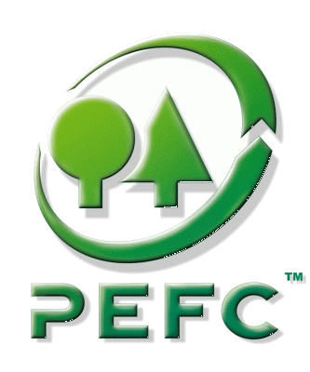
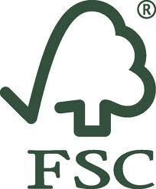
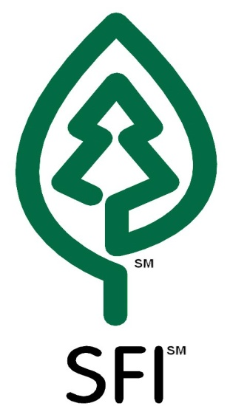
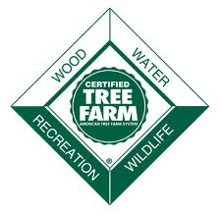
Certification Pathways
FSC (Worldwide)
PEFC (Worldwide)
SFI (North America)
ATFS ( United States)

Slide 18
Certified Acres by Region 2011
Region | Total Forest Ac. | SFI Certified | Tree Farm Certified | FSC Certified
Minn., Wis., Mich. | 52.2 mil | 16.0 mil | 3.6 mil | 17.0 mil
Maine, NH, New York | 41.2 mil | 7.6 mil | 1.8 mil | 6.6 mil
La., Ark., Miss. | 52.7 mil | 7.9 mil | 4.1 mil | 1.8 mil
Ga., SC, NC | 56 mil | 4.7 mil | 3.4 mil | 17,320 ac total !!!

Slide 19
What are the Implications for Landowners and Mills?
Could be an Opportunity for those landowners able and willing to become certified.
Or could be a problem for those unable to meet standards or not open to change.
Could be an Opportunity for our mills to become even more competitive globally.
Or could be a big problem if they loose market share and are forced to close.

Slide 20
What is Happening on the Ground with Certification ?
Tree Farm System is now accepted by PEFC so Tree Farmers can now opt to be PEFC Certified.
There are now FSC Groups operating in North Carolina that can provide a certification mechanism for small to medium sized landowners.
IP and Domtar are actively supporting FSC in addition to PEFC (SFI). Soon more wood using industries in NC will adopt FSC. Pine Lumber is and will continue to be the laggard on the certification front.

Slide 21
In Summary
Sustainability Policies are now standard operating procedures for large corporations because implementation leads to greater profits. Forest Certification is a component of those Policies.
FSC Certification appears to have gained a greater foothold with major wood fiber users.
Therefore our paper companies need to source more and more FSC wood fiber in a region with little currently available if they are to stay viable.
The demand for certified wood may create serious problems for our Landowners and Mills or it could become a competitive opportunity.

Slide 22
greenlinkstewards.com
Kleenex FSC Commercial

